Slide 1
10 Dec 2020, 14:00–14:25 (CET)
Webex
Nuclear data generation using Gaussian process regression and its related topics
Hiroki Iwamoto
Japan Atomic Energy Agency
Reference
H. Iwamoto, “Generation of nuclear data using Gaussian process regression”
Journal of Nuclear Science and Technology 57(8), 2020, 932–938.

Slide 2
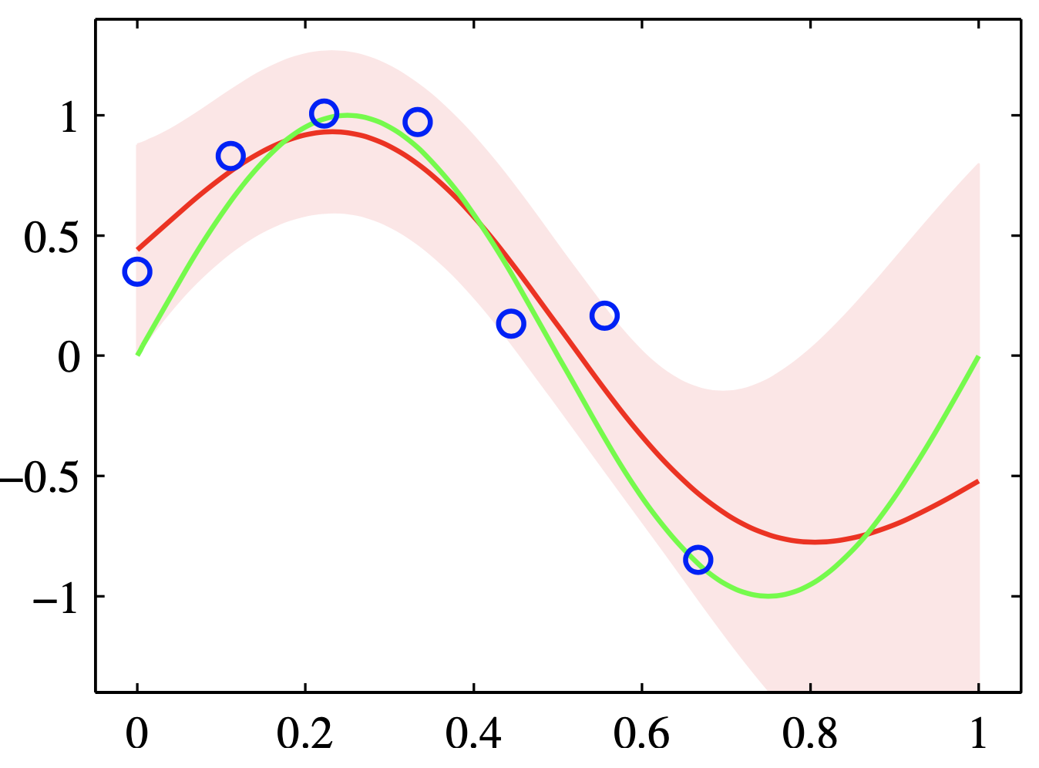
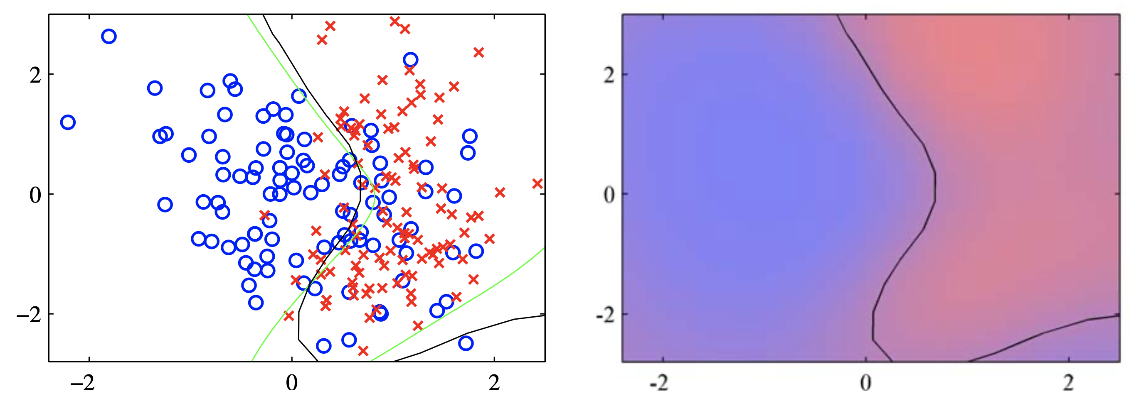
Gaussian processes
What is a Gaussian process?
Generic supervised learning method designed to solve regression and classification problems
2σ uncertainty
Mean of predictive distribution
https://scikit-learn.org/stable/modules/gaussian_process.html
Advantages
Bayesian inference (Uncertainty estimation)
Non-parametric method
Flexible
Gaussian process regression (GPR)
Classifier
Predicted probability
for crosses (×)
Disadvantage
Computationally expensive
Predicted probability
for circles (◯)
Possible solution: GPyTorch
Geoff Pleiss, et al., “Constant-time predictive distributions for Gaussian processes” Proc. ICML 2018; 2018
Gaussian process classification (GPC)
Reference: C.M. Bishop, Pattern recognition and machine learning, Springer (2006)

Slide 3




Gaussian process regression (GPR)
Assumption:
We have measured data points (measurement energy points and corresponding cross-sections with uncertainties ) for a certain nuclear reaction and we aim to generate a set of cross-sections for certain energy points
Gaussian process model
Joint probability of and follows Gaussian distribution:
$$y$$
$N ×$ measurement points
Cross section
Mean
Covariance
Taking 0 for simplicity, a zero-mean Gaussian process is expressed as
$M ×$ generated points
(*)
Energy
$$x$$
↑ Basic formula of Gaussian process

Slide 4
Gaussian process regression – Formula
Theorem for conditional Gaussian distributions
If a joint probability distribution for two sets of variables and is Gaussian , where
then the conditional distribution of is also Gaussian , where
Substituting the above theorem to (*), a conditional distribution is expressed as follows
where
← Formula of Gaussian process regression

Slide 5

Gaussian process regression – Kernel function and hyperparameter
Covariance matrix
Joint probability distribution
The element of covariance
Sub-covariance
Kernel function
Gaussian noise
Experimental uncertainty
Sub-covariance
$${C(x_{i},x_{j})}_{ }=k\left(x_{i},x_{j}\right)$$
Kernel function and hyperparameters
2
Kernel function：
1
0
RBF: Radial Basis Function
-1
-2
-3
: a set of hyperparameters
-4
-2
0
2
4
RBF kernel

Slide 6

Gaussian process regression – Optimization of hyperparameters
Optimization of hyperparameters
Solve a maximization problem of evidence :
where
( dimensional Gaussian distribution)
Gradient method
where
$k$: iteration number, $η$: learning rate

Slide 7
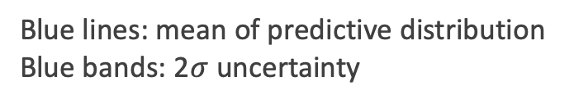
Nuclide-production cross-sections
Blue lines: mean of predictive distribution
Blue bands: 2$σ$ uncertainty
Cross-section
Advantages of GPR
Smooth cross-section curves from experimental data
Uncertainty expressed as a function of incident energy
Uncertainty
（1 standard deviation）
Uncertainty reduces as the number of experimental data increases
GPR contributes to efficient experimental design

Slide 8
Application to random sampling
Random samples (10 samples)
Cross-section
Correlation matrix
Advantage of GPR
Random samples can be easily generated according to
Gaussian processes are applicable to uncertainty quantification (UQ) in research fields of reactor physics and shielding analysis

Slide 9
Comparison with other models and evaluated nuclear data
TENDL-2019
GPR
JENDL-4.0/HE
INCL++/ABLA07
INCL4.6/GEM
ENDF/B-VIII.0
INCL++/ABLA07
JENDL-4.0/HE
GPR
INCL4.6/GEM
TENDL-2019
Advantage of GPR
(Needless to say) GPR agrees very well with the experiments

Slide 10
Case of experimental data lacking
JENDL-4.0/HE
INCL++/ABLA07
JENDL-4.0/HE
INCL++/ABLA07
INCL4.6/GEM
INCL4.6/GEM
TENDL-2019
GPR
TENDL-2019
Auxiliary points
No experimental data
→ large uncertainty
Disadvantage of GPR
Possible solution
GPR gives unacceptably large uncertainty
It may be necessary to give some physical knowledge as training data.
Advantage of GPR
Large uncertainty motivates new experiments

Slide 11
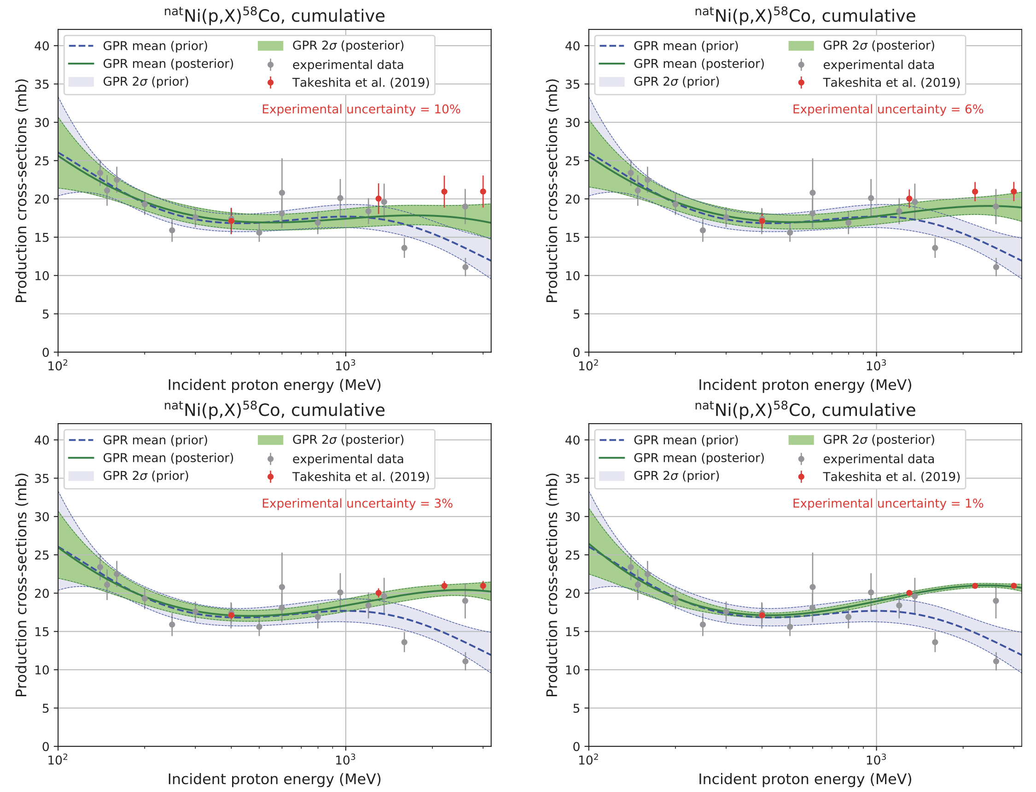
Influence of experimental uncertainty
Blue lines with bands
Green lines with bands
Result without the inclusion of new experimental data
Result with the inclusion of new experimental data
†New experiments: H. Takeshita et al., J-PARC symposium (2019)
Note
Experimental uncertainty largely affects regression results
Careful estimation of experimental uncertainty is important

Slide 12
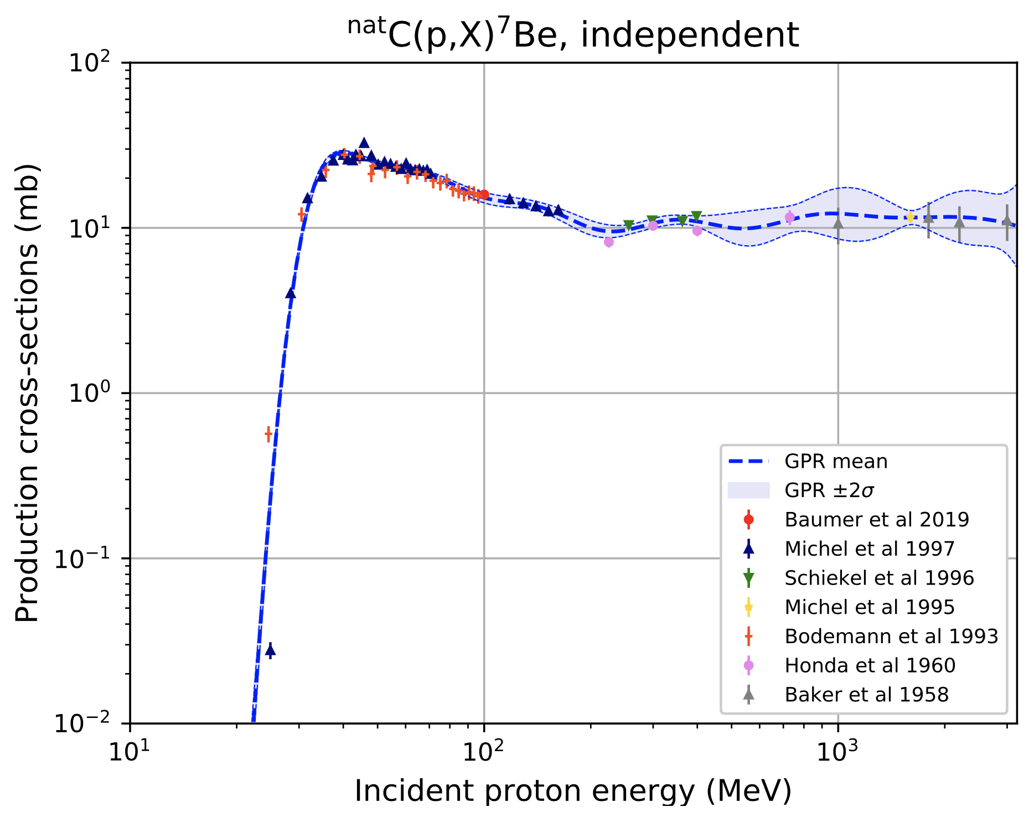
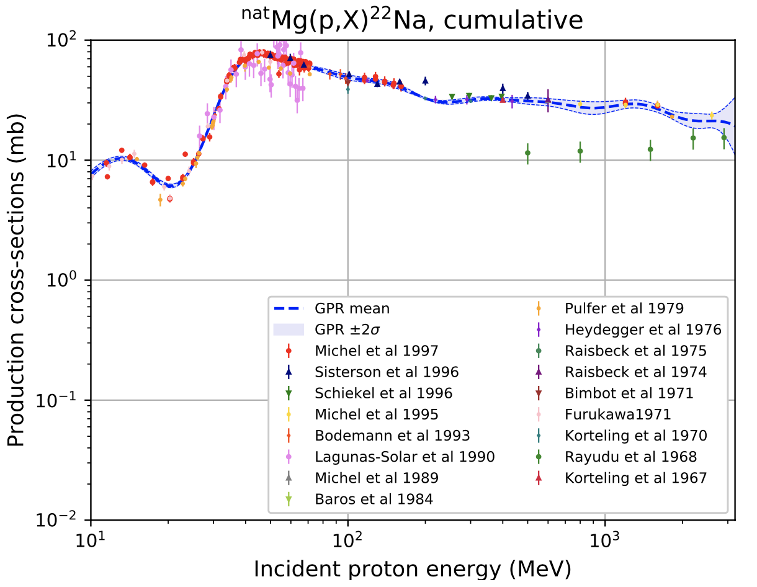
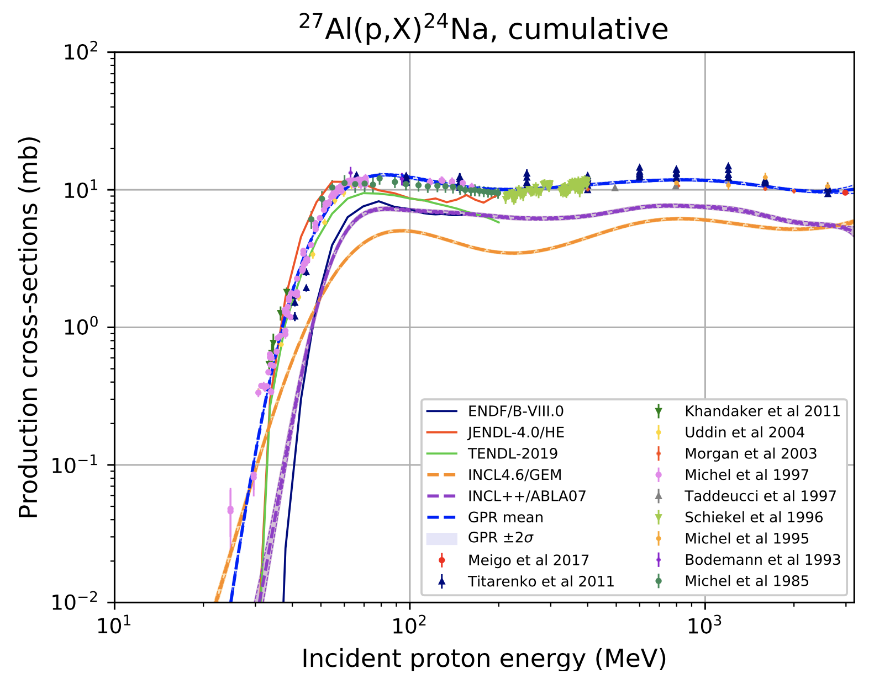
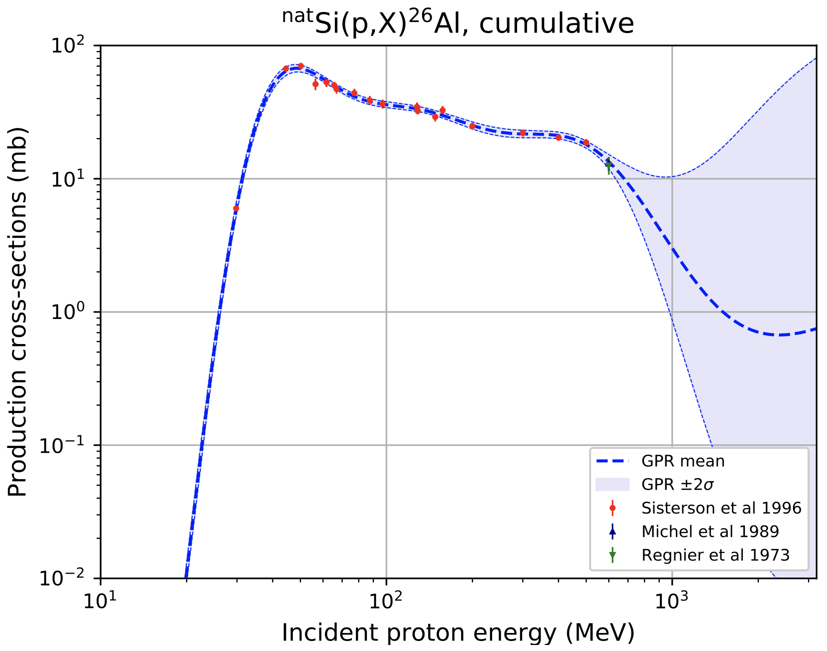
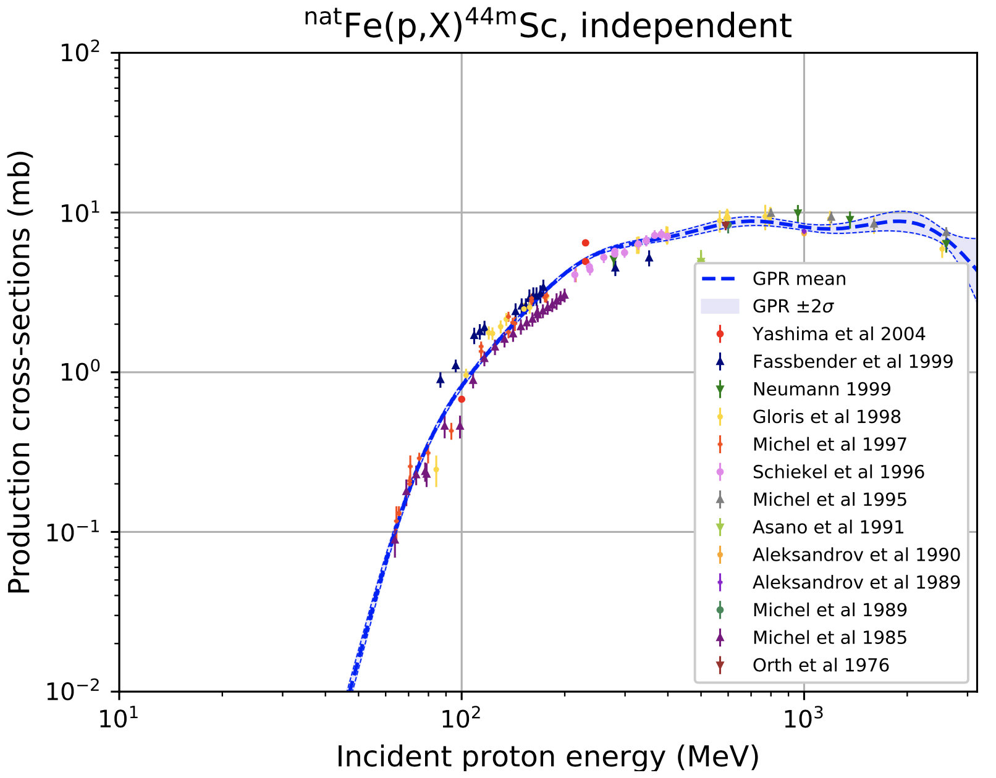
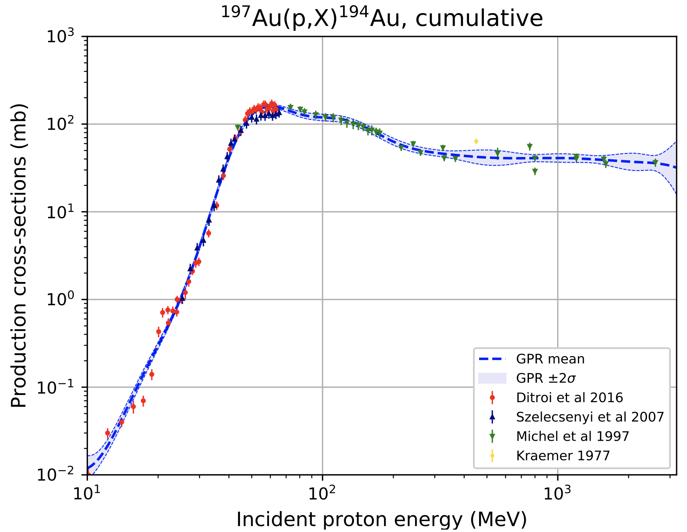
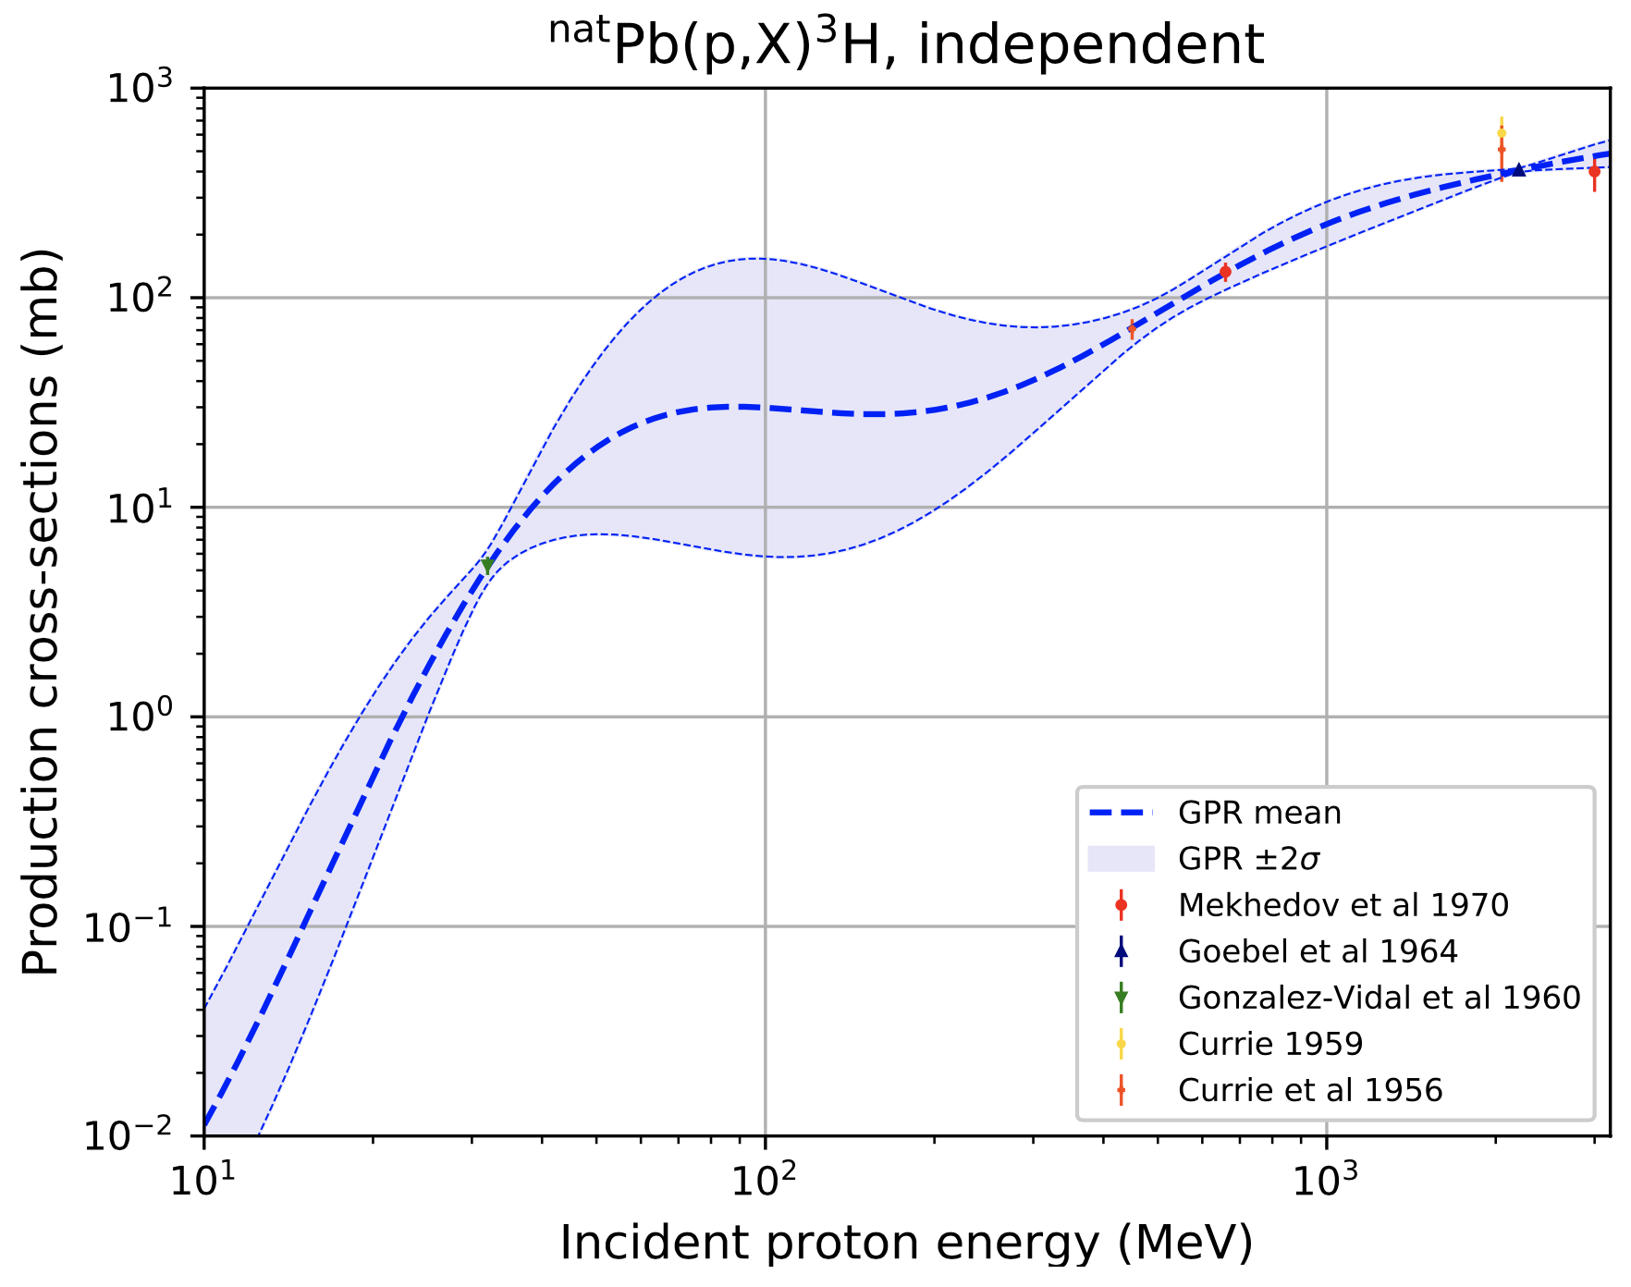
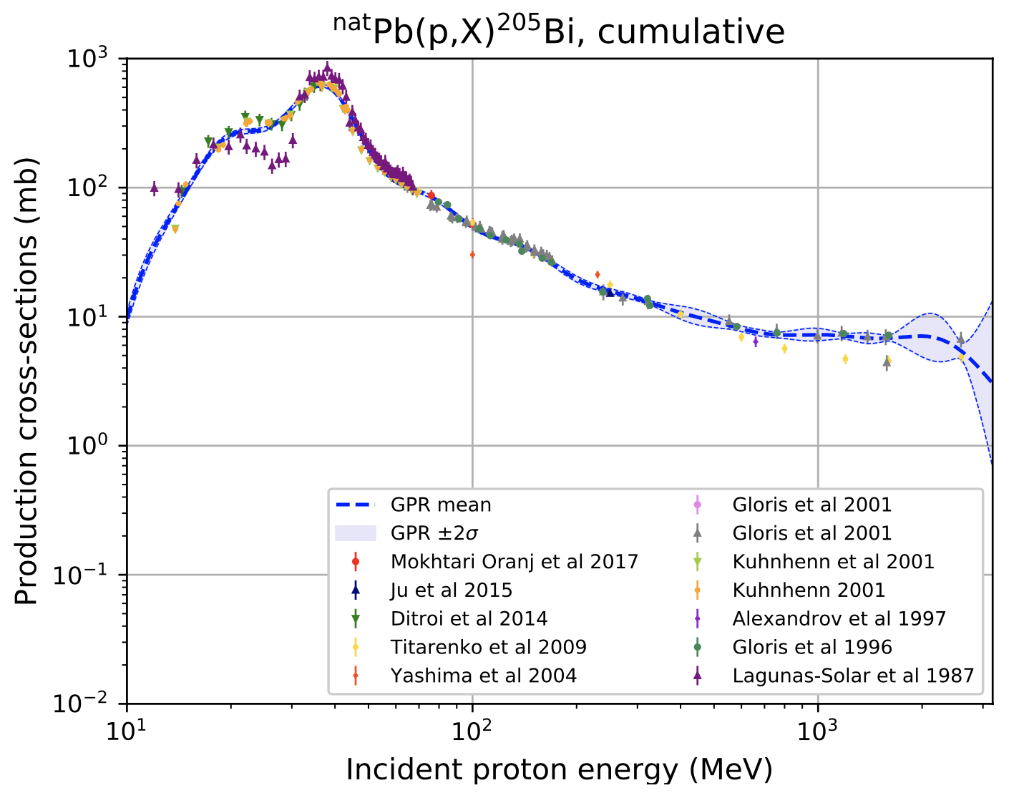
Other examples – Nuclide-production cross-sections

Slide 13
Other examples – Fission cross-sections
²³⁷Np(n,fission)
²⁴¹Am(n,fission)
Cross sections (mb)
Preliminary
GPR is expected to generate any shapes of cross-sections
However, methodology should be improved for cases of the large number of training (experimental) data

Slide 14

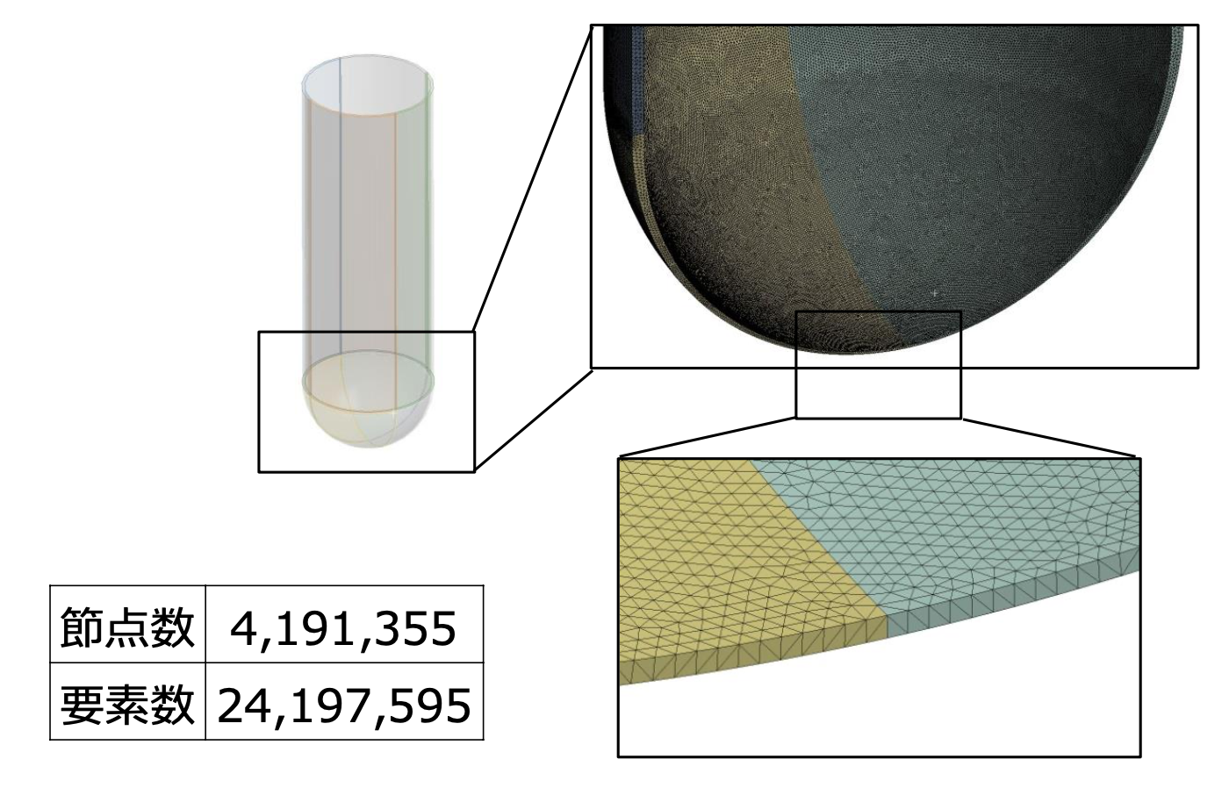

Smoothing of output data in MC transport calculation
Coupled neutronics thermal-structural analysis with PHITS/ANSYS/FLUENT:
1.5-GeV proton beam
Detailed thermal-structural analyses require an ultrafine mesh geometry, involving excessive calculation cost to reduce the statistical uncertainty
Beam window
Number of nodes: 4,191,355
Number of elements: 24,197,595
Geometry of a beam window for Accelerator-Driven System (ADS)
Radial distribution of heat deposition of ADS beam window calculated with PHITS ($Δθ=0.1°$)
Drawing with ANSYS

Slide 15
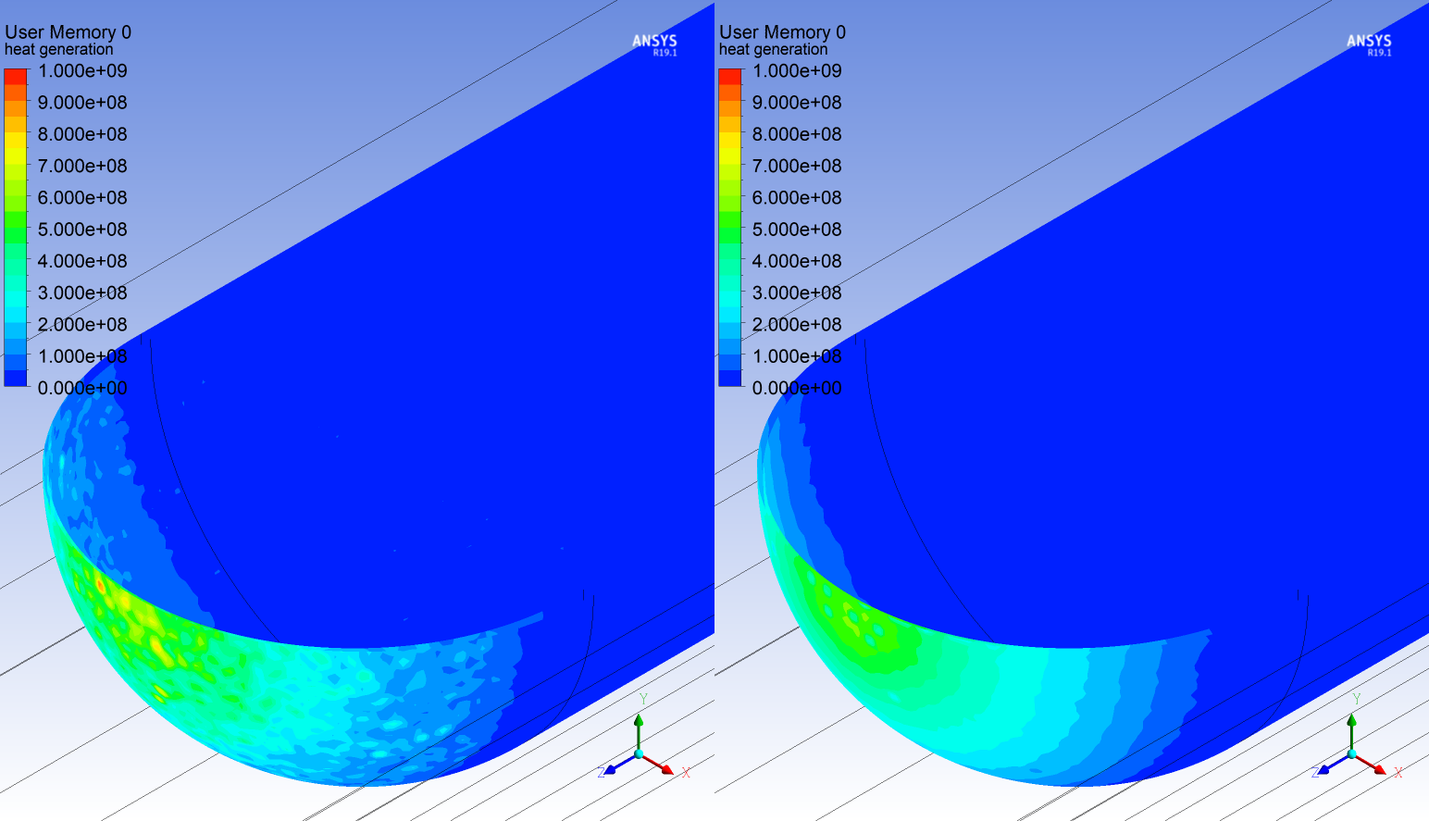
Smoothing of output data in MC transport calculation
Before processing (PHITS)
After processing with GPR
Proton beam
Proton beam
Radial distribution of heat deposition of ADS beam window induced by a 1.5-GeV–30-MW proton beam
Beam window
Beam window
3-dimensional distribution of heat deposition for ADS beam window induced by a 1.5-GeV–30-MW proton beam
Drawing with ANSYS

Slide 16
Summary
We have applied the GPR technique to generate nuclear data, mainly focusing on proton-induced nuclide production cross-sections.
Reasonable curves with corresponding uncertainties were obtained and the results indicate that this approach is effective for generating nuclear data.
Our results suggest that this approach can be applied in experimental design to reduce the uncertainty of generated nuclear data.
Thank you very much for listening.

